Slide 1
HSE DEMO
Introduction
2 and 3 December 2013

Slide 2

HSE DEMO
SAM editor
SAM Environment
SIA’s
1- Business requirements and Dataset
2- SAM editor introduction: constructing a dataset
3- The SAM editor life demo
4- Semantic Interoperability Artefacts (SIA’s)
5- SAM Environment (tbd)
© ERS 2013

Slide 3
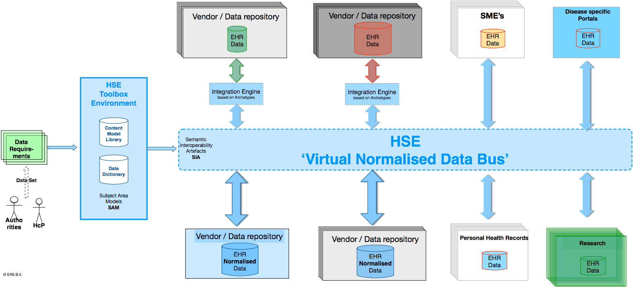

Slide 4
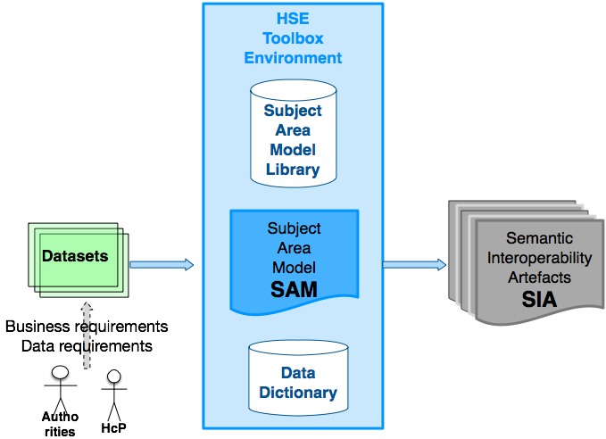
From ‘Information’ Requirements to Semantic Interoperability Artefacts

Slide 5
Business needs
Data needs
Stakeholders:
  Healthcare providers
  Health organisations
  Payors
  Authorities
  Research
Stakeholders have ‘information’ needs
Each for its own business needs
© ERS 2013

Slide 6

Datasets
‘Information’ needs
(Data needs)
are expressed as:
Datasets
© ERS 2013

Slide 7
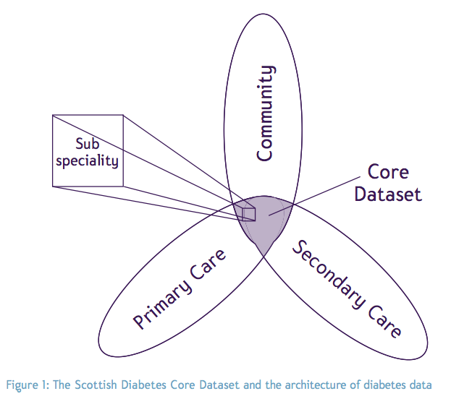
Datasets
Kinds of ...

Slide 8
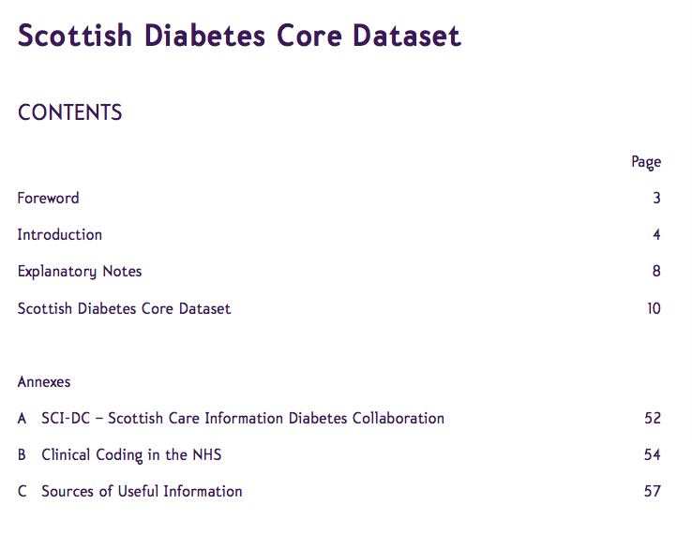

Slide 9
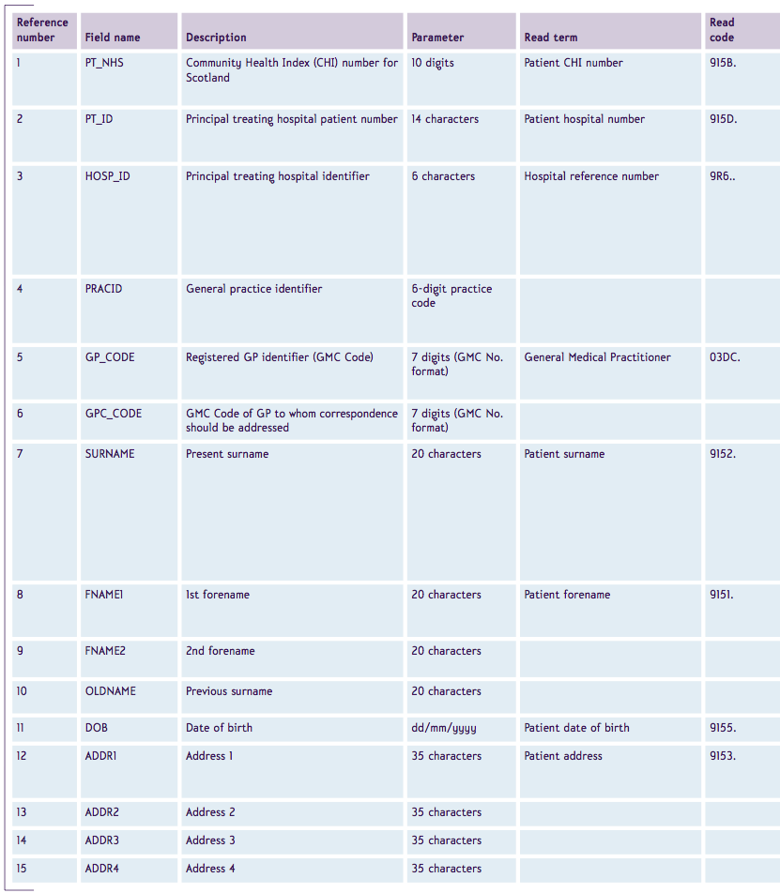
Dataset example

Slide 10
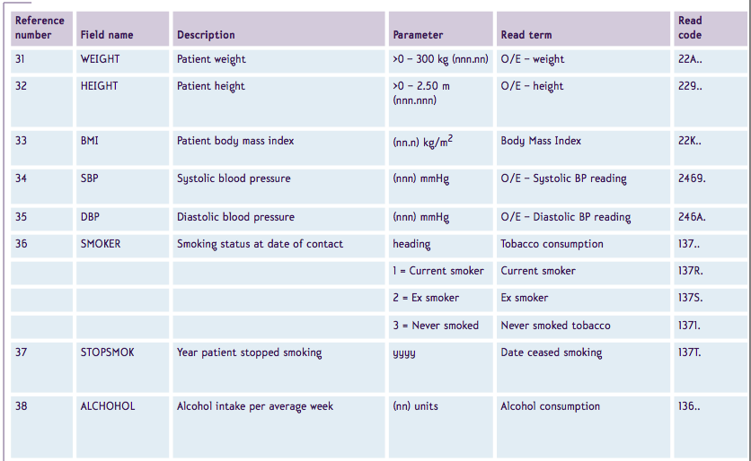
Dataset example

Slide 11
Dataset
Datasets:
  express the data needs of stakeholders
  can be used in procurement
  specify what IT-systems must be able to handle (store, retrieve, exchange)
  facilitate reporting, collaboration, and research
© ERS 2013

Slide 12
From ‘Information’ Requirements to Semantic Interoperability Artefacts

Slide 13
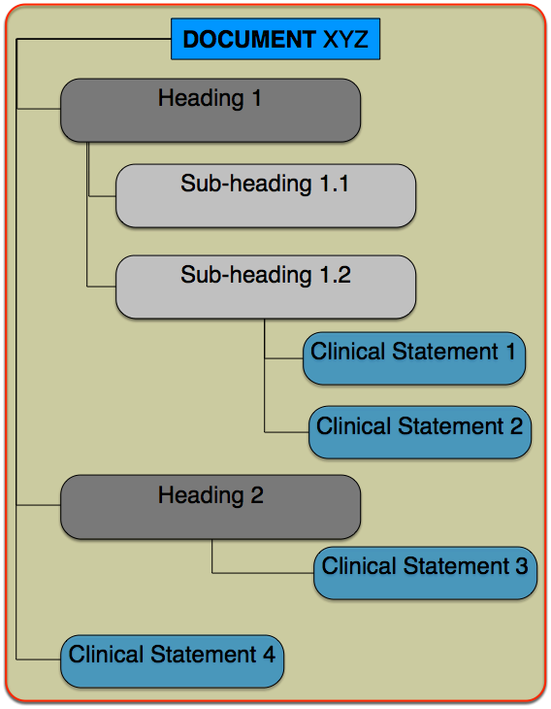
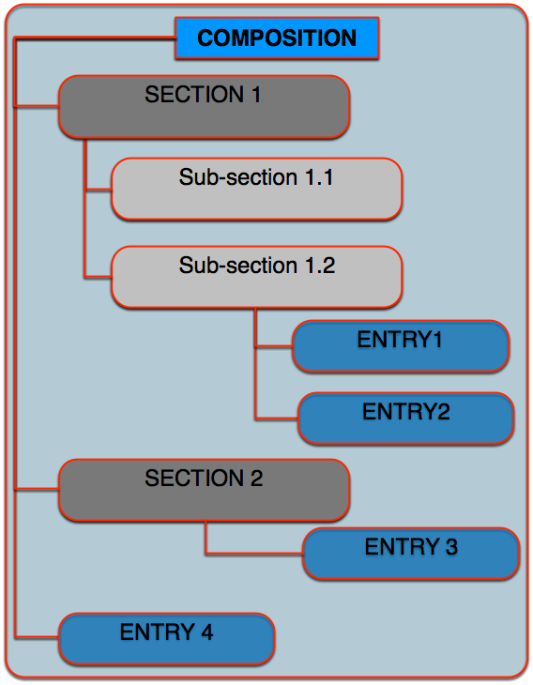
From Data Set to Subject Area Model

Slide 14
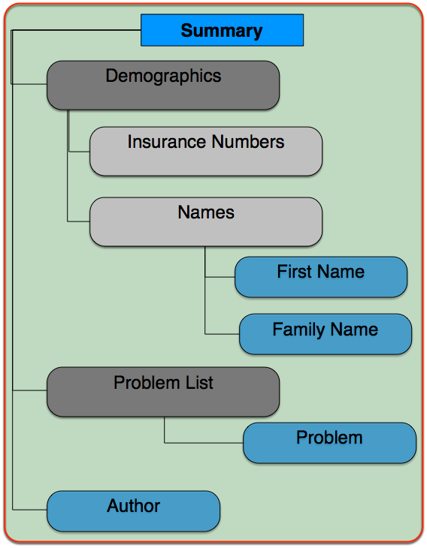
From Data Set to Subject Area Model

Slide 15
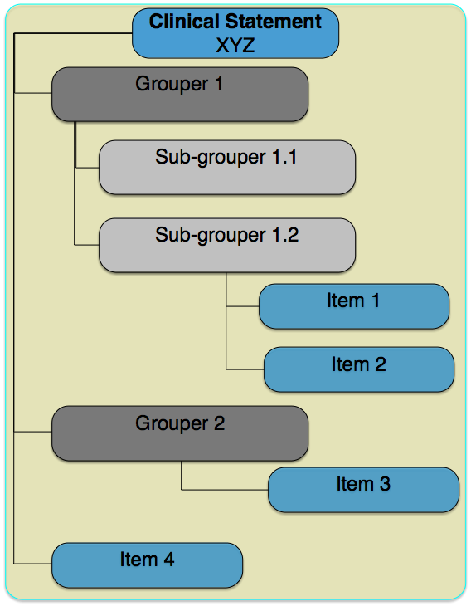
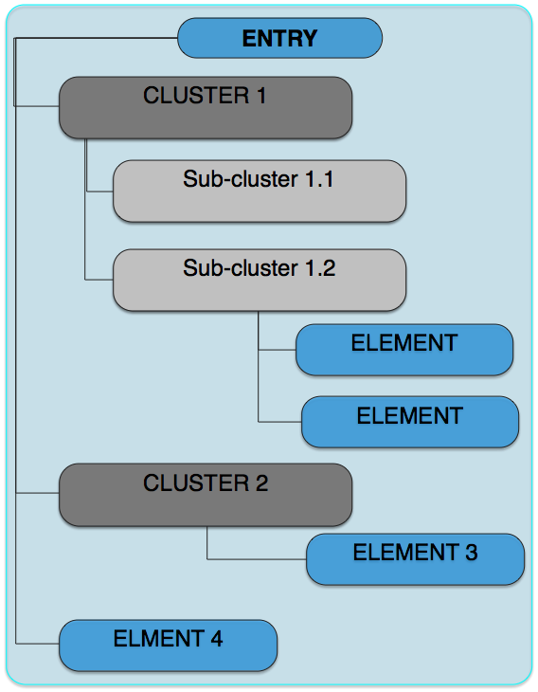
From Data Set to Subject Area Model

Slide 16
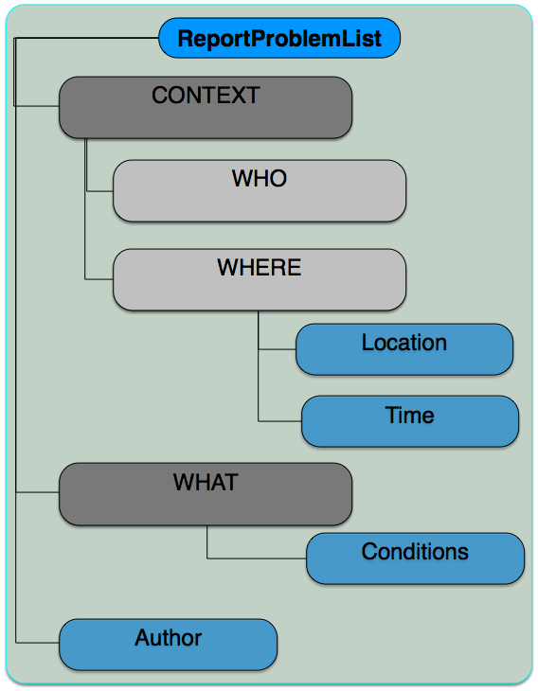
From Data Set to Subject Area Model

Slide 17
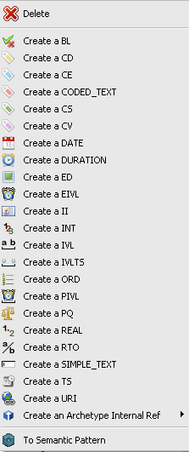
From Data Set to Subject Area Model
Data Types
Simple text
TS
CD
Simple text

Slide 18
From Data Set to Subject Area Model
Cardinalities
Occurrences
Codes
Annotations
Loinc: 1234
ContSys: Problem Lst
0-2
0-2
0-1
0-1
1-1
1-1
1-1
1-1
SNOMED: 123.234
Loinc: 4567
ContSys: HealthCondition
Any local or international code
1-…
1-…
1-1
1-1

Slide 19
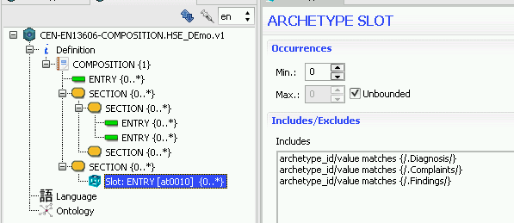
HSE Toolset
SAM Editor

Slide 20
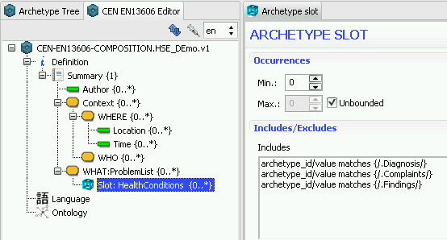
HSE Toolset
SAM Editor

Slide 21
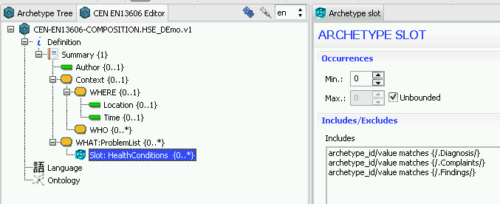
HSE Toolset
SAM Editor

Slide 22
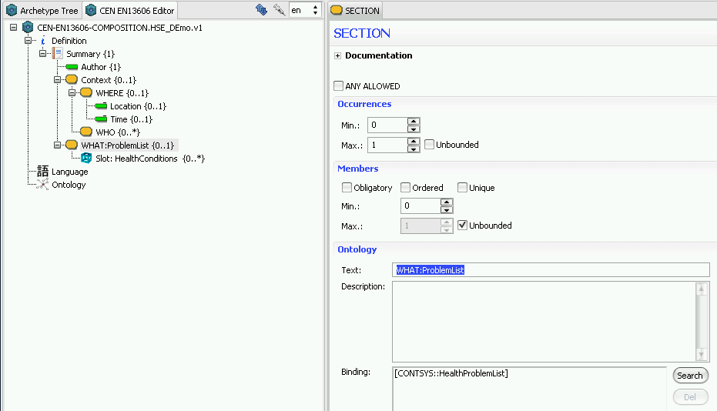
HSE Toolset
SAM Editor

Slide 23
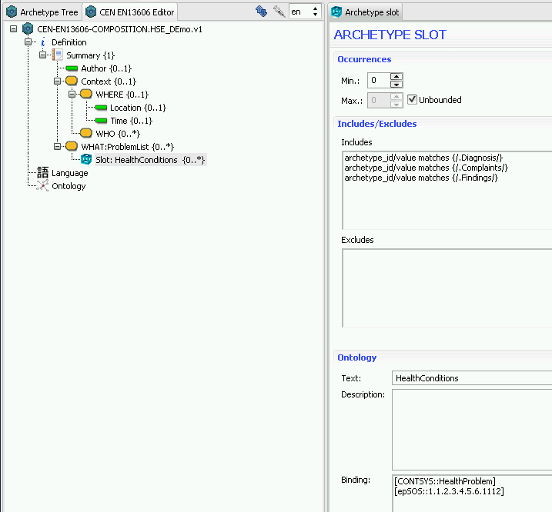
HSE Toolset
SAM Editor

Slide 24
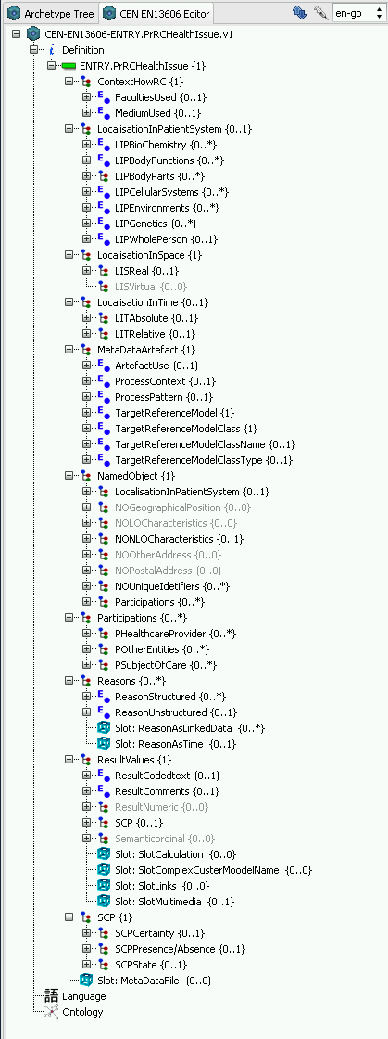
HSE Toolset
SAM Editor

Slide 25
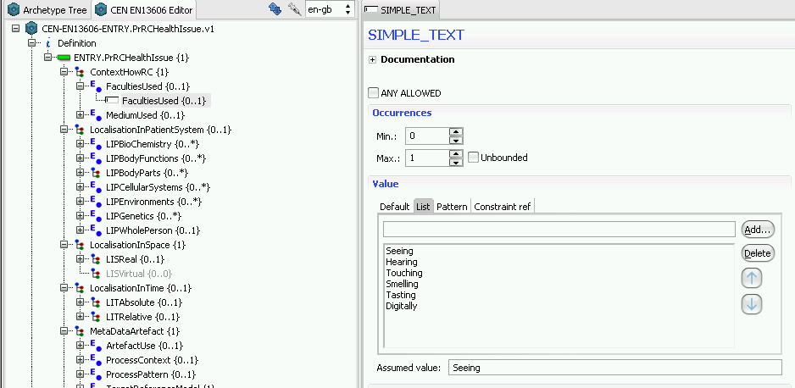
HSE Toolset
SAM Editor

Slide 26
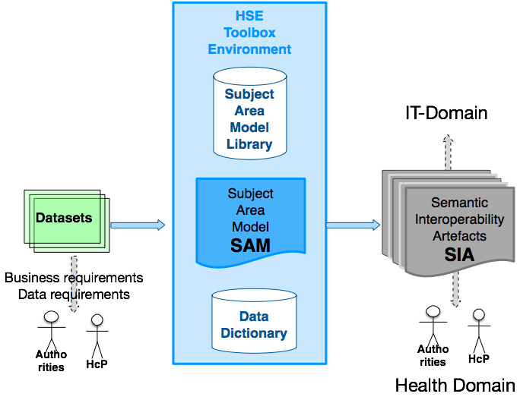
From ‘Information’ Requirements to Semantic Interoperability Artefacts

Slide 27
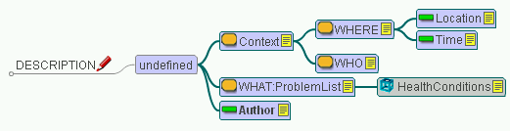
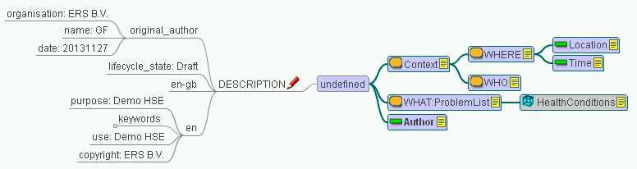
Mind Map

Slide 28
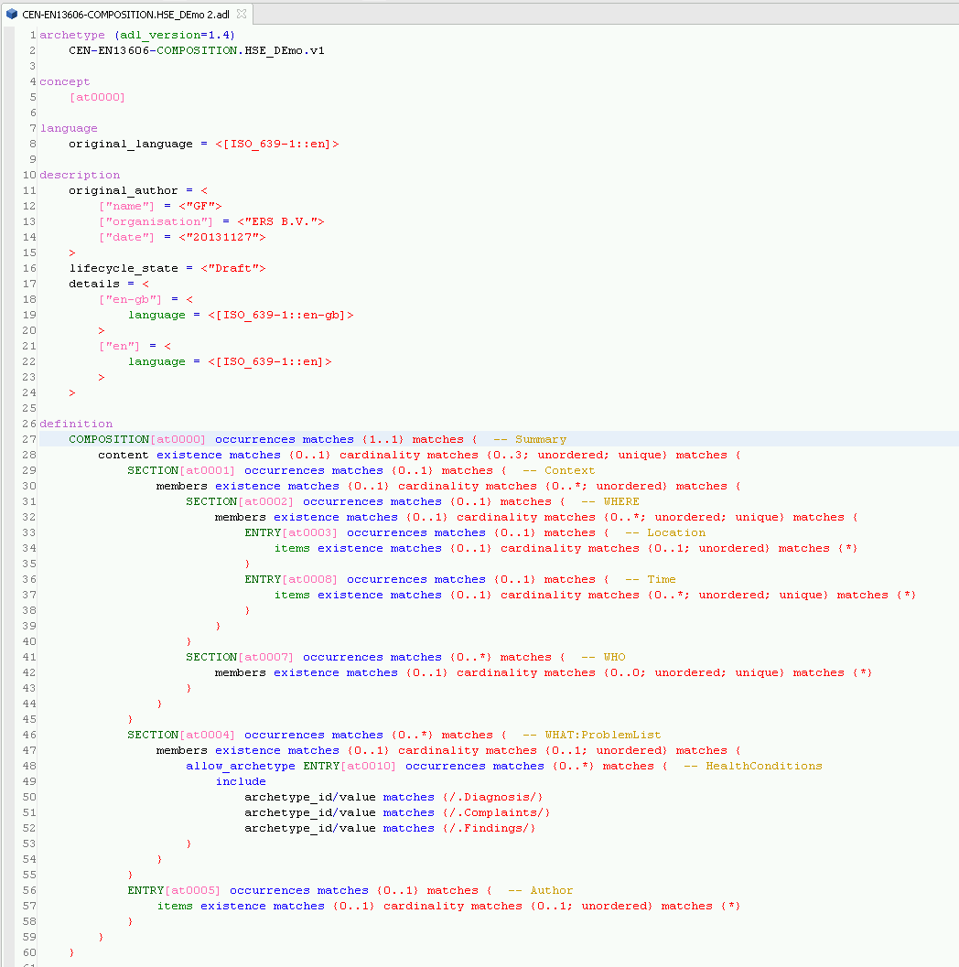
ADL

Slide 29
Conclusion
  A Data Set can be converted in a precise standards based Semantic Interoperability artefact
  The artefacts can be inspected by:
    Stakeholders in the Health knowledge domain
    (SAM Editor, Mind Map, HTML) and
    Stakeholders in the IT knowledge domain
    (ADL, XML instantiation)
© ERS 2013

Slide 30
DEMO
Subject Area Model Editor
© ERS 2013

Slide 31
SAM Environment
[tbd]
© ERS 2013

